Slide 1
Notes:
The whole slide still subject to slight change for the rest of the week.

Slide 2
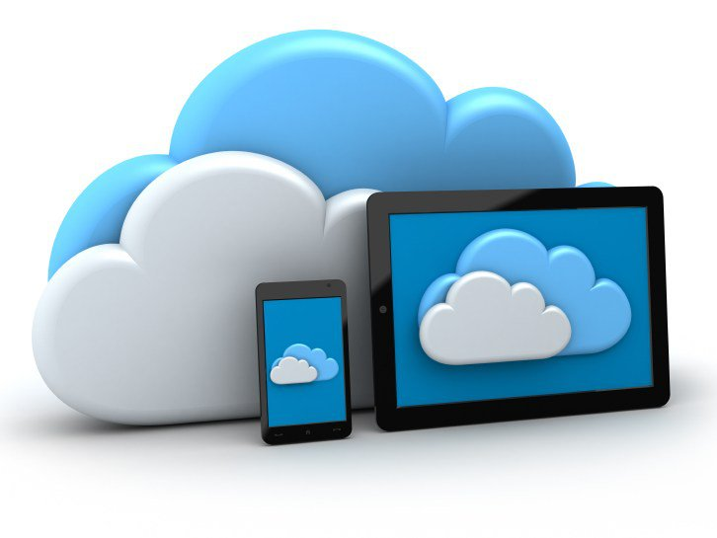
Mobile Cloud Computing
- The fundamental infrastructure for mobile devices
Ting Chen - 190408
Notes:
Hello everyone, today I’ll talk about the mobile cloud computing technology.
As we all know, mobile devices make up the majority of our daily usage nowadays.
Mobile cloud, as an infrastructure, is essential in daily life. So let’s begin.

Slide 3
Overview of Mobile Cloud Computing (MCC)
Definition
Architecture
Key advantages
Major issues
Enabling technologies
Applications
Conclusion
As mobile users, Offline or Intermittent connectivity is a fact of life. Mobile networks simply don't provide that same level of consistency that we get from the desktop. We, as app developers can’t keep building applications with the desktop mentality of assuming we have a permanent, fast and reliable connection.
The time has come for mobile app developers to accept reality.
SQLite-sync.com
Notes:
In this lecture, I’ll present with the following sections.
First I’ll give some definitions from different sources, which defines mobile cloud from different aspects.
Then I’ll discuss the common architecture of mobile cloud, talk about some advantages and issues existing for it.
Also, I’ll talk about those technologies and application that make mobile cloud so popular today.
On the right is a paragraph I came across on GitHub…

Slide 4
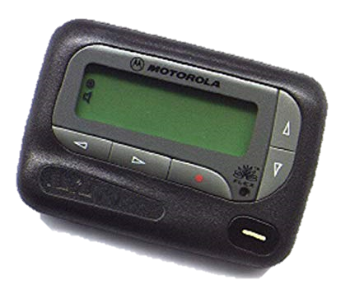
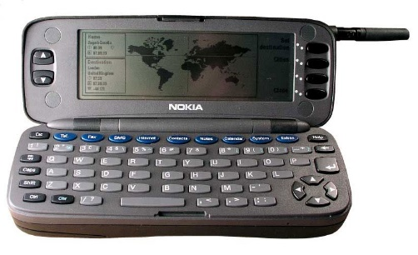
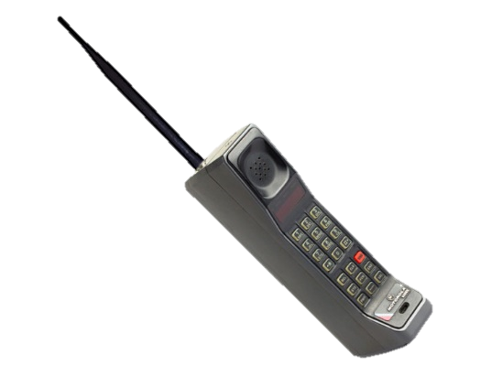
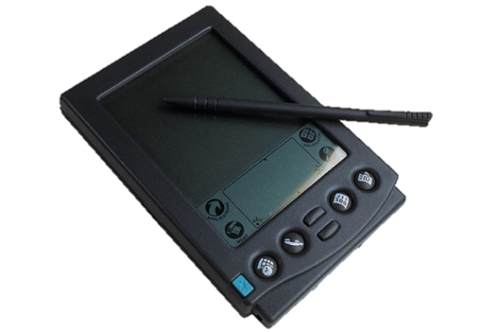
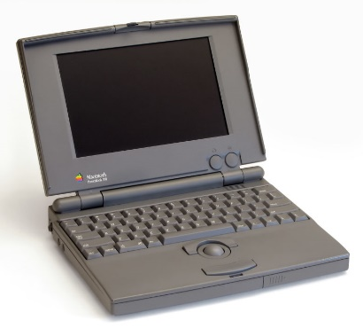
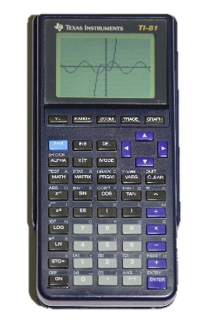
0 Overview - Before Cloud…
The idea of mobile computing came out early.
There were… quite a few “mobile devices”!
Many concepts have come out at that age.
Some of the problems are still practical till today.
Even not a topic before 2010!
Images courtesy: medium.com, Wikipedia.org
Notes:
http://phones-thenandnow.weebly.com/1990-2000.html
Before starting to talk about mobile cloud, I want first to introduce the idea of mobile computing. While mobile cloud is pretty much a newer idea, coming out at 2010, mobile device is an old idea.
Believe it or not! Even before we born, there are already bunch of mobile devices.
In the paper: fundamental challenges in mobile computing
Connectivity, resource limited, battery technology
Caching – mobile cdn,
Global estimation of connection: signal strength, packet rate, rtt, etc to achieve better QoS
Some concerns at that age, while some of these are still practical till today.
By definition, there are graphing calculator, pda, “smart” cell phone, laptop, pagers.
1991 (July 1)- 2G Cellular Telecom - GSM
1993 (April)- The First Tablet Computer with Wireless Connectivity – email and fax
1996- The First Access to the Mobile Web - Nokia Communicator 9000 phone. It was the first mobile phone and handheld computer. Maybe similar in james bond movie?
In the paper: fundamental challenges in mobile computing
Connectivity, resource limited, battery technology
Caching – mobile cdn,
Global estimation of connection: signal strength, packet rate, rtt, etc to achieve better QoS
iPhone 4, AppStore, Android, the burst of smartphones, the birth of 4G LTE in Sweden, and popularity of 3G
In a word, MCC is to solve some of the problem of mobile computing

Slide 5
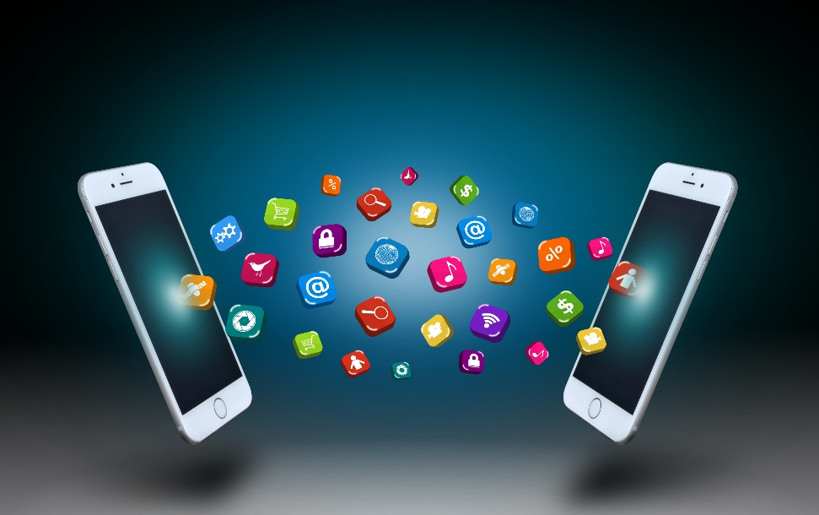
0 Overview - The need is real
My mobile app – computing intensive processes
Mobile payment
Mobile commerce
Mobile service platform
Lightweight/thin client
Mobile healthcare
Traditional software move to handheld devices
…
Notes:
Also, the need for mobile cloud is real: I’ll give a few examples.
The incentive for taking this topic is from my own project.
While taking advantages of cell phone’s sensors are great, handling the data as well as storing them is not really handy for a resource limited platform. That is also one of the key constraints for mobile device.
Also, another really popular scenario is the mobile payment applications. In china, it’s really popular! Marcus will tell us more about that in a couple of weeks.

Slide 6
1 Concept - Definition
The MCC forum defines it as follows:
Mobile Cloud Computing at its simplest, refers to an infrastructure where both the data storage and data processing happen outside of the mobile device. Mobile cloud applications move the computing power and data storage away from mobile phones and into the cloud, bringing applications and MC to not just smartphone users but a much broader range of mobile subscribers.
According to Wikipedia:
Mobile Cloud Computing (MCC) is the combination of cloud computing, mobile computing and wireless networks to bring rich computational resources to mobile users, network operators, as well as cloud computing providers.
Notes:
the availability of cloud computing services in a mobile ecosystem. This incorporates many elements, including consumer, enterprise, femtocells, transcoding, end-to-end security, home gateways, and mobile broadband-enabled services.
for mobile applications whereby the data processing and storage are moved from the mobile device to powerful and centralized computing platforms located in clouds. These centralized applications are then accessed over the wireless connection based on a thin native client or web browser on the mobile devices.
Alternatively, MCC can be defined as a combination of mobile web and CC
The key idea is to leverage the elastic resources of clouds toward more functionalities.
I’d say mobile cloud services are both. The goal is to overcome or mitigate the limitations of mobile device by taking advantage of cloud technologies.

Slide 7
1 Concept - Other definitions
Three definitions proposed by Mobile cloud computing: A survey
✔️
Fig. 2. A virtual resource cloud made up of mobile devices in the vicinity.
Fig. 1. A remote cloud server catering to mobile devices though the internet.
Fig. 3. A cloudlet to bypass latency and bandwidth issues while benefitting from its resources.
Notes:
1st definition is the most common understanding
2nd group up devices in proximity in an ad hoc fashion. Applications like FireChat. For ios the tech behind is the Multipeer Connectivity Framework, with specific feature AirDrop.
3rd is a cloudlet infrastructure. A cloudlet is a miniature of cloud, the concept in edge computing, academia.
Coffee shop, what is a latte, maybe look up for you instantly. Or the translation of menu, based on user history.
The left figure is what we mainly considered as a mobile cloud these days, while the other are also under discussion.

Slide 8
1 Concept - Comparison between MCC and CC
Mobile cloud inherits many concepts from cloud computing
Scalability
Self-awareness/on-demand provisioning
Multitenancy
Also, mobile cloud has some specific considerations
Mobile cloud computing is more consumer-oriented, comparing to the businesses cloud.
Just as the Wikipedia definition, MCC = clouds designated for mobile devices and applications.
Notes:
, such as scalability performed and scaled to meet the unpredictable user demands due to flexible resource provisioning
self-awareness (environment change) - for service providers and mobile users to run their applications without advanced reservation of resources.
Multitenancy - Service providers can share the resources and costs to support a variety of applications and large number of users.
Which I’ll cover later in the slides. Mobile cloud is special in many cases comparing to general cloud services. Especially needs to consider other aspects such as mobility, low connectivity and finite source of power as well.
what is the relation between MCC and CC: key constraints that differs - connectivity, bandwidth, availability, battery, computing resources

Slide 9
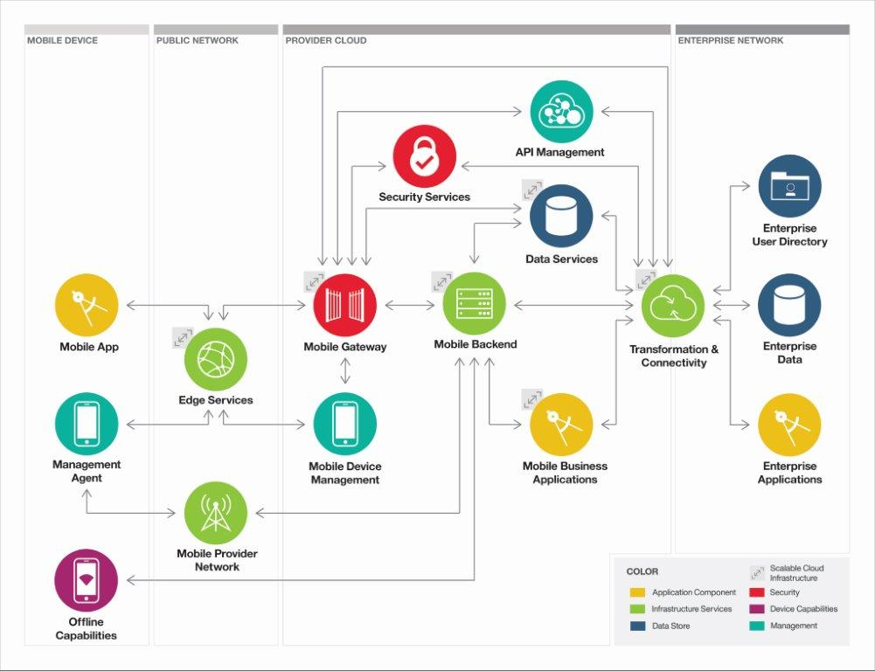
2 Architecture
Adapted from Cloud Customer Architecture for Mobile

Slide 10
2 Architecture
Roughly can be divided into user-end and server-end.
Mostly can be viewed as an SaaS infrastructure
Sometimes can be PaaS or IaaS. E.g. GAE, Azure; Amazon S3
Different layer provides different features.
Notes:
•Mobile Device
•Public Network, which connects the device to the mobile cloud services
•Provider Cloud environment, where the various cloud services exist
•Enterprise Network, containing existing enterprise applications, services and data
We usually use the app, software, rather than build our own app.
App: user interaction
Network: firewall, dns, load balance
Gateway: authentication, authorization, policies
Backend: handle requests, compute, notification, data management and synchronization
For example, a duke university catalog.

Slide 11
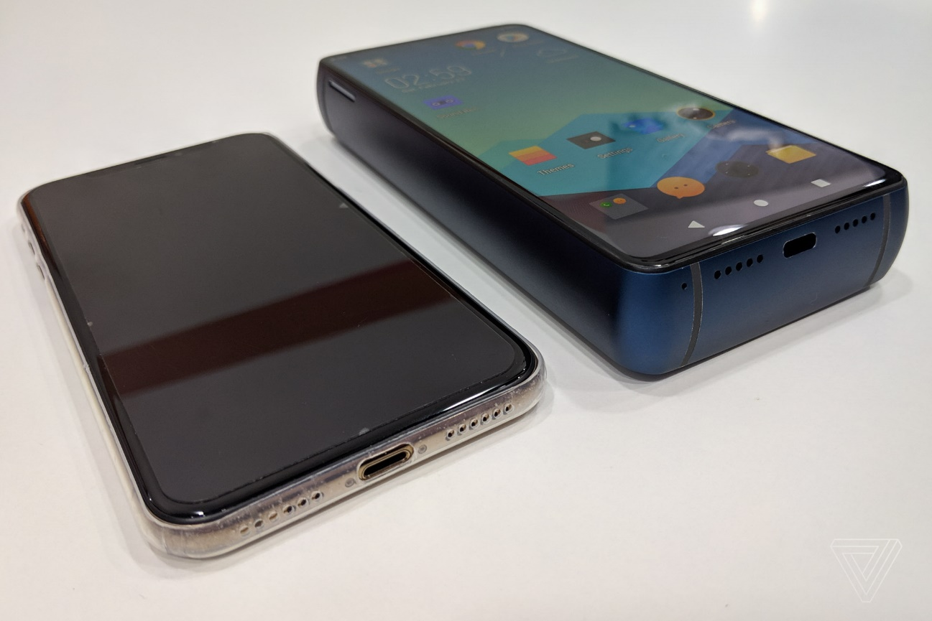
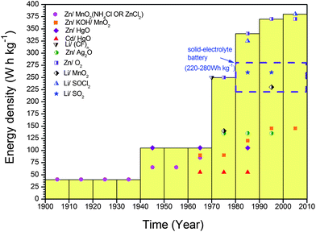
3 Advantages - battery life
In the 1994 paper, the author was pessimistic about battery’s future
Nokia engineers estimate 5% annual growth
There will always be more energy consuming computations!
MCC is a good makeshift to mitigate this issue.
Battery is life for applications.
Computation offloading – move intensive computation to the cloud
D. Linden and T. B. Reddy, Handbook of Batteries, 3rd Edition, McGraw-Hill, New York, 2002
Notes:
Who have ever had battery issues when you are outside and cannot find a charger right away?
Balance between transmitting data and process locally
Computation offloading technique is proposed with the objective to migrate the large computations and complex processing from resource-limited devices (i.e., mobile devices) to resourceful machines (i.e., servers in clouds). This avoids taking a long application execution time on mobile devices which results in large amount of power consumption.
The energizer 18000 milliamp Hour phone – a power bank with a screen!

Slide 12
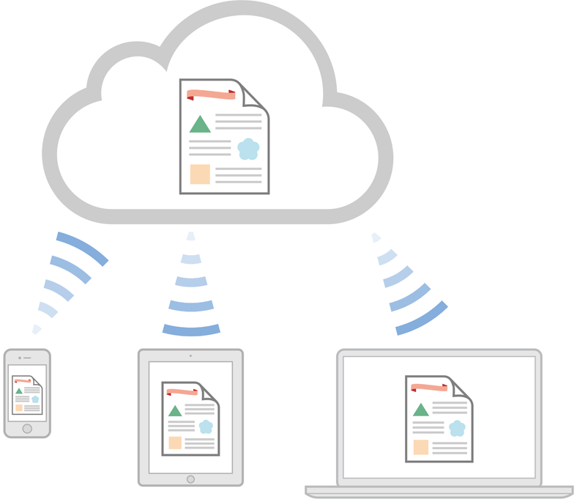
3 Advantages - storage and computation
Amazon S3, iCloud, OneDrive, DropBox, Box, Google Drive, etc.
Backup (reliability)
Share among devices/user group
E.g. Google photos
Notes:
No maintenance worries, just use the features
Simple and intuitive
Subscription payment methods
Literally unlimited storage with paid price
Sync among devices
Users may access all images from any devices. With
the cloud, the users can save considerable amount
of energy and storage space on their mobile devices
because all images are sent and processed on the
clouds.
Is a combination of two

Slide 13
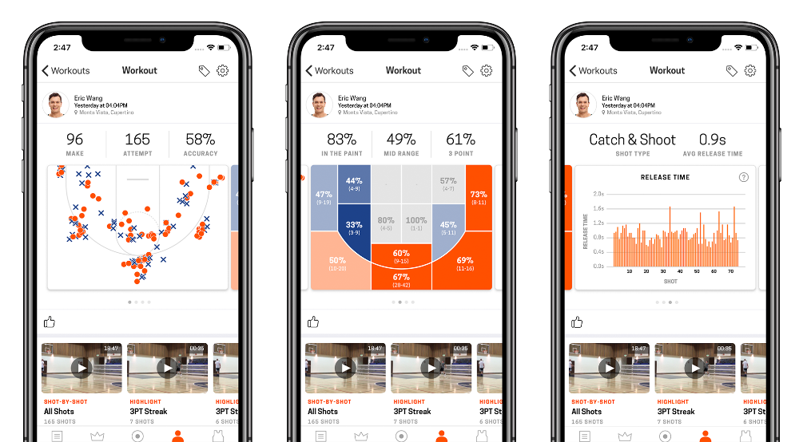
3 Advantages - storage and computation
Reduce runtime for intensive task
A “counter-example”: HomeCourt
Cloud can provide a variety of services
Combined with cloud storage, there are more possibilities.
Notes:
Storage capacity is also a constraint for mobile devices. MCC is developed to enable mobile users to store/access the large data on the cloud through wireless networks.
First example is the Amazon Simple Storage Service [22] which supports file storage service. Another example is Image Exchange which utilizes the large storage space in clouds for mobile users [23]. This mobile photo sharing service enables mobile users to upload images to the clouds immediately after capturing. Users may access all images from any devices.With the cloud, the users can save considerable amount of energy and storage space on their mobile devices because all images are sent and processed on the clouds.
Flicker [24] and ShoZu [25] are also the successful mobile photo sharing applications based on MCC. Facebook [26] is the most successful social network application today, and it is also a typical example of using cloud in sharing images.
Counter example
there are two competing factors for the app: either compress locally and upload with less data, or upload and compress remotely
Compression consume valuable battery life: 5 videos -> more than half of my battery
Upload and compress: cost company bandwidth fare as well as backend computing power.
Especially image processing for video games, speech synthesis, speech recognition, natural language processing, augmented reality, wearable computing, encoding for video and images
Larger matrix operation

Slide 14
3 Advantages – reliability & other
Copyright protection – Apple music, Spotify, Amazon Music, QQMusic
Backup and redundancy – generally safer than local-only storage
Accessibility
Scalability
Reusable SDK and easier APIs
Deliver to multiple OSes
*Environment friendly
Notes:
Backup data in the cloud: Disaster Recovery, less chance to data loss due to physical damage as well as wrong operation
For example,
the cloud can be used to protect copyrighted digital
contents (e.g., video, clip, and music) from being
abused and unauthorized distribution
copyright - spotify, amazon music, apple music, qqmusic can be better managed with mcc for providers, XOR encryption with header/metadata rsa'd
In addition, MCC can be designed as a comprehensive data security model for both service providers and users. For example, the cloud can be used to protect copyrighted digital contents (e.g., video, clip, and music) from being abused and unauthorized distribution [30]. Also, the cloud can remotely provide to mobile users with security services such as virus scanning, malicious code detection, and authentication [31]. Also, such cloud-based security services can make efficient use of the collected record from different users to improve the effectiveness of the services.
With mobile APIs like iCloud, Amazon and Google Firebase, it’s easy to develop a fine-grained app without the pain to write your own java web APIs. Essentially there are professionals handle that for you, but still…
Using less Non-ferrous metal used to produce chips and ics.

Slide 15
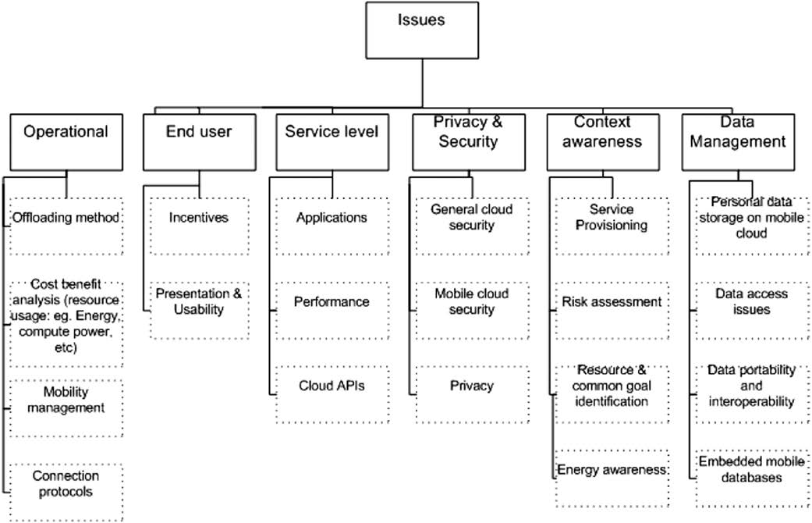
4 Issues
Mobile CDN
A taxonomy of issues in mobile cloud computing. – adapted from Mobile Cloud Computing: A survey
Notes:
Mobile devices (e.g., smartphone and tablet PC) are increasingly becoming an essential part of human life as the most effective and convenient communication tools not bounded by time and place. Mobile users accumulate rich experience of various services from mobile applications (e.g., iPhone apps and Google apps), which run on the devices and/or on remote servers via wireless networks. The rapid progress of mobile computing (MC) [1] becomes a powerful trend in the development of IT technology as well as commerce and industry fields. However, the mobile devices are facing many challenges in their resources (e.g., battery life, storage, and bandwidth) and communications (e.g., mobility and security) [2]. The limited resources significantly impede the improvement of service qualities.

Slide 16
4 Issues – network
Connectivity
Availability
Bandwidth
Fallbacks for offline devices – how to deal with data consistency
Maintaining channels consume power when signal is weak
Solution - Different protocols for various scenarios – WiFi, Bluetooth, LTE, etc.
Newly proposed network models
Notes:
The main problem is to deal with intermittent connection and possible status
Bandwidth is one of the big issues in MCC because the radio resource for wireless networks is much scarce as compared with the traditional wired networks.
Before WiFi a/c and 3G, bandwidth was a considerable big problem.
Streaming live media is not possible at that time, with 2Mbits/s connection. I remember my household had used that for at least 3-4 years.

Slide 17
4 Issues – computing offloading
Offloading is one of the main features of MCC to improve the battery lifetime for the mobile devices and to increase the performance of applications.
How to determine whether offload or not?
Energy trade-off analysis
Cost analysis
Algorithmic estimation – minimize a certain metric
Difficulty level to program
…
Examples: HomeCourt, Omnimoji, Siri
“Mobile Thin Client” – Chromebook, most web-based apps, game streaming, WeChat miniprogram
Notes:
Most approaches use the data size and execution time of computations to find the optimal program partition for offloading and assume that such an information is known before the execution. However, it is difficult to obtain the accurate execution time of computations because the time varies in different instances of the computations, and the inaccurate information results in inefficient offloading performance.
If a feature is hard to program on a certain device, maybe offload it to the backend
Backend is like a full functioning tool box while mobile device is just a subset of it.
Thin client is an old concept: server-client in a company. New devices can also adopt this term

Slide 18
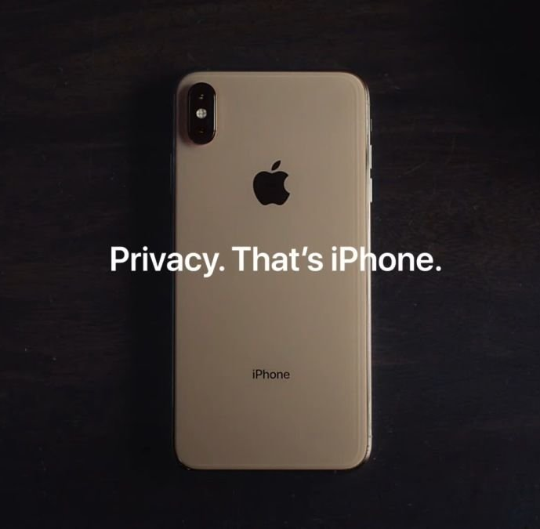
4 Issues – privacy and security
Mobile devices are easier to lose
Security mechanisms are not as good as desktop tools
Indeed, mobile device provide handy authorization methods with bio-sensors
GPS/Location based tracking
Camera peeking
More vague area - Recommender System
GDPR, encryption, etc.
A short live demo
Notes:
Protecting user privacy and data/application secrecy from adversary is a key to establish and maintain consumers’ trust in the mobile platform, especially in MCC
the security related issues in MCC are in two categories: the security for mobile users and the security for data.
With the advantages of GPS positioning devices, the number of mobile users using the location based services (LBS) increases. However, the LBS faces a privacy issue when mobile users provide private information such as their current location. This problem becomes even worse if an adversary knows the user’s important information. Location trusted server (LTS) [86] is presented to address this issue.
Sensitive data exposure
Data integrity, authentication, DRM copyright

Slide 19
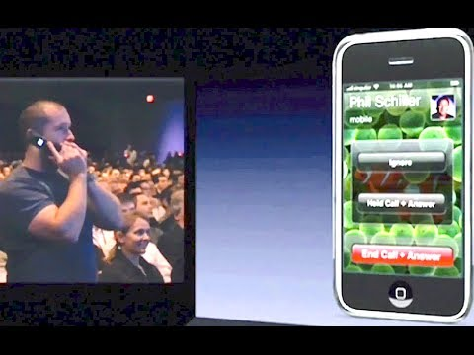
4 Issues - Live Demo
Let’s do it
in Apple style…
Notes:
my privacy software of GPS remover, compression solve the issue - most online services does not preserve metadata
Easy to solve: compression, screenshot, remove metadata
“share with no sensitive data” toggle

Slide 20
5 Enabling technologies
Network and communication – 2G/3G/4G, WiFi, coding scheme, atenna
Sensors – GPS, gyroscope, camera, fingerprint, microphone, NFC
Other hardware
For cloud computing
Virtualization
Distributed computing
Data center
Services
CDN
…
*Cloudlet – Prof. Mahadev Satyanarayanan
http://elijah.cs.cmu.edu/
Notes:
Near field communication
Flash player is deprecated due to bad power consumption
Cloudlet is a theoretical model, but not really practical, by cmu, edge computing, still some sort of cache
only soft state
powerful, well-connected and safe
close at hand
builds on standard cloud technology
Might be more useful after 5G get popular
Intermediate layer between real cloud and mobile device
A cloudlet is a new architectural element that arises from the convergence of mobile computing and cloud computing. It represents the middle tier of a 3-tier hierarchy: mobile device --- cloudlet --- cloud. A cloudlet can be viewed as a "data center in a box" whose goal is to "bring the cloud closer". A cloudlet has four key attributes:
only soft state: It is does not have any hard state, but may contain cached state from the cloud. It may also buffer data originating from a mobile device (such as video or photographs) en route to safety in the cloud. The avoidance of hard state means that each cloudlet adds close to zero management burden after installation: it is entirely self-managing.
powerful, well-connected and safe: It possesses sufficient compute power (i.e., CPU, RAM, etc.) to offload resource-intensive computations from one or more mobile devices. It has excellent connectivity to the cloud (typically a wired Internet connection) and is not limited by finite battery life (i.e., it is plugged into a power outlet). Its integrity as a computing platform is assumed; in a production-quality implementation this will have to be enforced through some combination of tamper-resistance, surveillance, and run-time attestation.
close at hand: It is logically proximate to the associated mobile devices. "Logical proximity" is defined as low end-to-end latency and high bandwidth (e.g., one-hop Wi-Fi). Often, logical proximity implies physical proximity. However, because of "last mile" effects, the inverse may not be true: physical proximity may not imply logical proximity.
builds on standard cloud technology: It encapsulates offload code from mobile devices in virtual machines (VMs), and thus resembles classic cloud infrastructure such as Amazon EC2 and OpenStack. In addition, each cloudlet has functionality that is specific to its cloudlet role.

Slide 21
5 Enabling technologies
Software
OS – iOS, Android, BlackBerry RIM, Symbian, Windows, OS X, etc.
AppStore – bring package control to people
Web – HTML5/CSS3, front-end, web API, REST
Smarter power control
Encryption algorithms
Compression/encoding algorithms
Many more!
Notes:
Without h264 and cdn, we’ll never see youtube

Slide 22
6 Applications
Mobile commerce
Alipay, Alibaba, Amazon, Ebay, PayPal
Mobile healthcare
HealthKit, Apple Watch
IoT integration, smart home
Mobile gaming
…
In fact, how many of you don’t use a mobile device?

Slide 23
7 Conclusion
3
2
1
Mobile cloud is ubiquitous nowadays.
Mobile cloud computing born with the need of increasing computing complexity on mobile devices.
Certain limitations apply to mobile cloud; various technologies aim at promoting it.

Slide 24
Discussions are welcome
Thanks for listening
Notes:
Below are some preparatory material from last slide, use if needed

